Slide 1
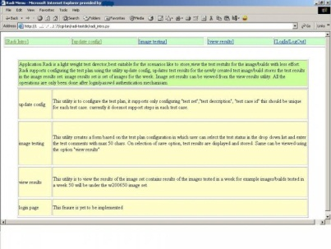
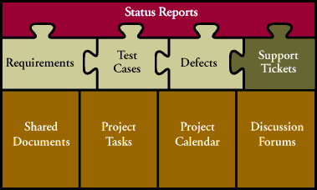
Tools for Management of Testing and Tests
Software Quality Assurance
Telerik Software Academy
http://academy.telerik.com

Slide 2


The Lectors
Snejina Lazarova
Project Manager
BI & Reporting Team
Dimo Mitev
QA Architect
Backend Services Team

Slide 3

Table of Contents
Test Case Management Systems (TCMS)
TestLink
General Information
Other Tools for test management
Microsoft Test Manager
HP Quality Center (ALM)
Custom Made TCMS

Slide 4
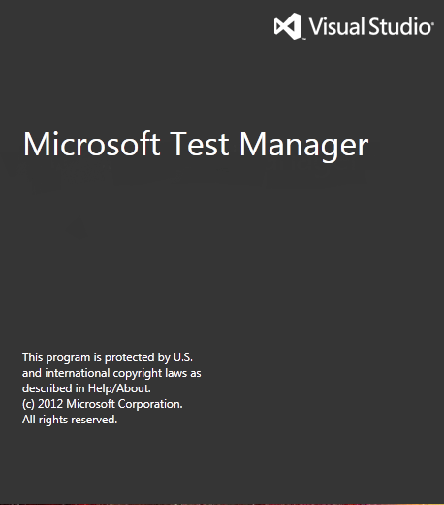


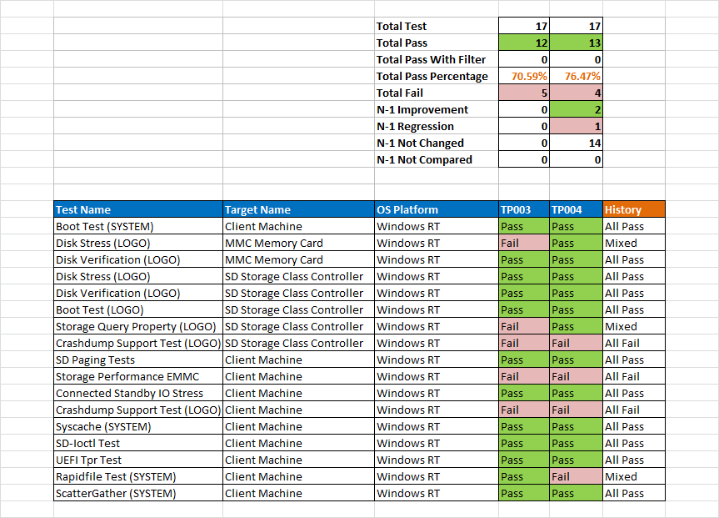
Test Case Management Systems (TCMS)

Slide 5

TCMS
What are Test Case Management Systems?
A single repository for linking project requirements, tests, test sets, results, reports, defects
Used to manage tests (automated or manual)
Can be associated with automation software
Can include requirement and/or
specification management modules

Slide 6

Requirements Based Testing

Slide 7
Requirements Based Testing
One or more test cases could be designed for every requirement
A combination of risk- and requirements-based testing could have some advantages:
Revealing missing requirements
Focus on the most important part of the system
Better communication with users and stakeholders
Easier negotiation and prioritization

Slide 8
Requirements Specification Document
Requirements are grouped to one or more System/Software/User Requirement Specifications
1
includes
Product
1
*
1
Requirements Specification
Test Specification
includes
1
1
*
*
Requirement
*
covers
Test Case
*

Slide 9
Test Plans
Test Plans are the basis for test execution activity
Test Plans include:
Name
Description
Collection of chosen Test Cases
Builds
Test Results
Milestones
Tester assignment
Priority definition

Slide 10
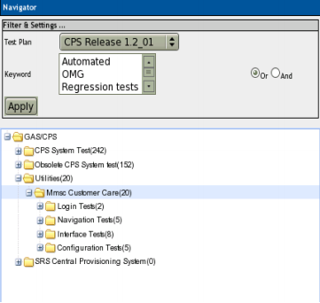
Test Sets
A test plan is defined by adding a test set (of test cases) from Test Specification
A particular version of a test case gets assigned to a test plan
Test sets allow modifying the execution order of test cases

Slide 11
Test Execution
Test execution is available after:
A Test Specification is written
A Test Plan is created
Test Cases are added into Test Plan
At least one Build is created
Testers have appropriate rights for execution to work with the this Test Plan

Slide 12
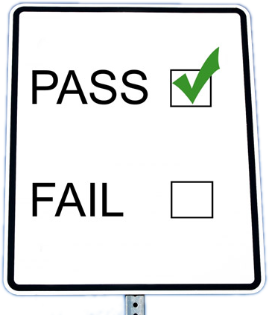

Test Status
Test execution results in labeling test cases as:
Pass
Fail
Blocked (impossible to test for some reason)

Slide 13
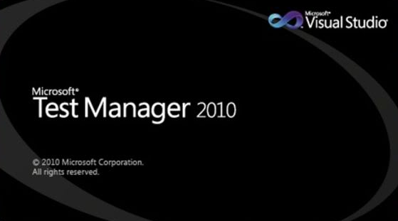
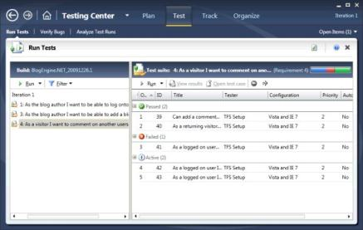
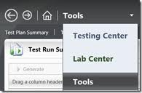
Microsoft Test Manager

Slide 14
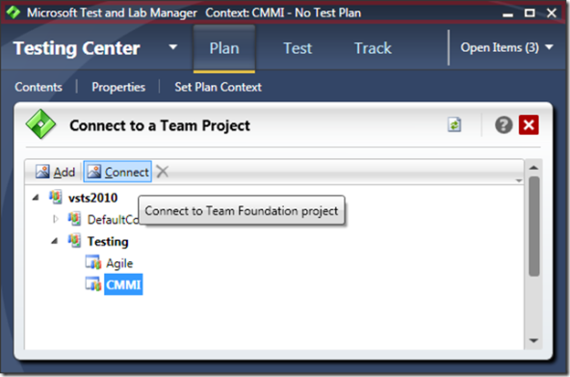
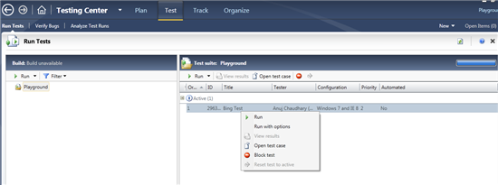
Microsoft Test Manager
Microsoft Test Manager allows:
Test Planning
Test Case Management
Running Manual/Automated Tests
Report Result and File Bugs
Integrated with TFS

Slide 15
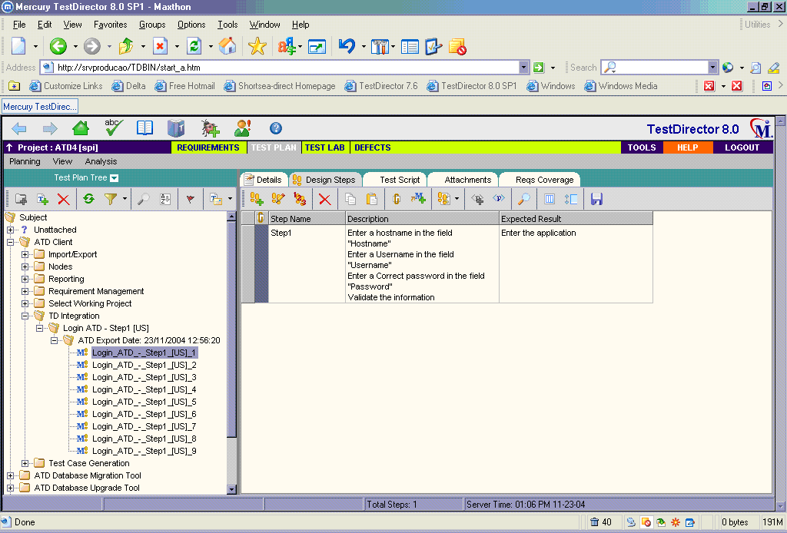
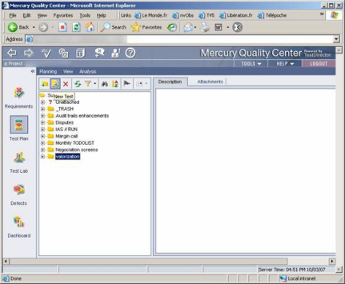
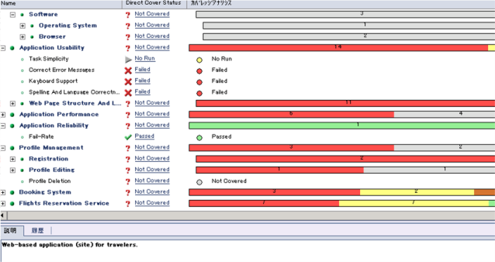
HP Quality Center (ALM)

Slide 16
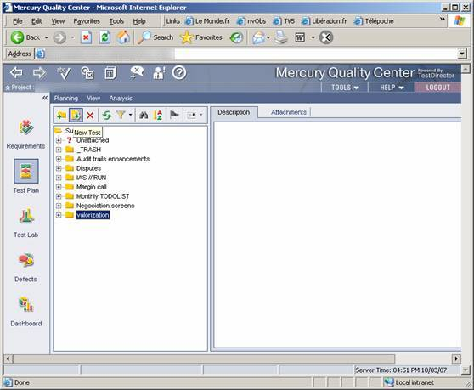
Quality Center
Test Director is currently available as a plug-in for Mercury Quality Center
Works on any browser that supports ActiveX technology
Test Director has four modules:
Requirements
Test Plan
Test Lab
Defects

Slide 17
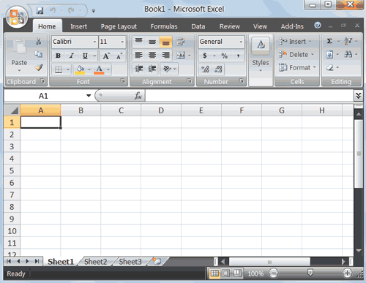
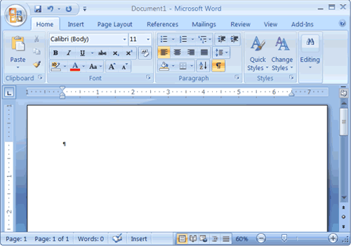
Custom Made TCMS
How can we make our own TCMS?
Demo

Slide 18
Tools for Management of Testing and Tests
?
?
?
?
?
Questions?
?
?
?
?
?
?

Slide 19




Free Trainings @ Telerik Academy
C# Programming @ Telerik Academy
csharpfundamentals.telerik.com
Telerik Software Academy
academy.telerik.com
Telerik Academy @ Facebook
facebook.com/TelerikAcademy
Telerik Software Academy Forums
forums.academy.telerik.com

